Slide 1

Software Engineering
Project: SMART COMMUTE WEB APP
Antonio Michele Del Negro -862516
Pável Pascacio De Los Santos-852255
Prof. Matteo Rossi
May, 2019

Slide 2
Smart Commute
Smart Commute is a web-based application that aims to make the user’s appointments scheduling easier by considering the time it takes to go from one place to another through integrated geolocation API’s. In addition, within the same application it saves the appointments’ addresses and durations and shows the best way to get from one place to another, warns you if there’s no time, and helps coordinate efficiently.

Slide 3
Software Development Life Cycle of Smart Commute
Feasibility study
Requirements Analysis & specification
Design
Coding & Unit Test
Integration & System Test
Deployment
Maintenance

Slide 4
Outline
1. Smart Commute Overview
2. Idea
2. Objective
3. Requirements
3.1 Use Case Diagram
3.2 Requirements
3.3 System Architecture
4. Design
4.1 High Level Class Diagram
4.2 Front-end Class Diagram
4.3 Back-end Class Diagram
4.4 Sequence Diagrams
4.4.A Log in and Load data to the App Environment
4.4.B Create an Event
4.4.C Modify and Delete an Event
4.4.D Select an Event on the Map
5. Implementation
5.1 Graphical User Interfaces
5.2 Used Tools and Code description
6. Testing
7. Conclusion and Future Works
Outline

Slide 5
Smart Commute Overview - Motivations
Work routines in big cities increasingly hectic and dynamic: several markets and industries demand quick and varied work routines
Encouragement to focus on what’s important and prevent user procrastination on smartphones
Motivation to develop browser native applications on a potential market: native web OS for smartphones (successful in India -> Kai OS)
Maximization of compatibility by using web based app: available to use in virtually any smart device, which means use in any kind of environment.
Smart Commute Overview

Slide 6
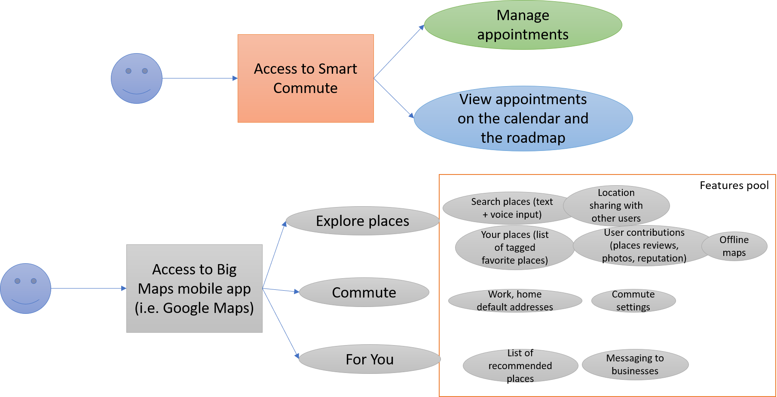
Idea
Dedicated app
Less functionality versus other mapping applications
Less audience, more focus on a specific feature
Focus on time optimization
Idea

Slide 7
Who?
Why?
In the market there is a wide variety of apps that provides a generic schedule and travel routing services, but any app is focused on a specific and ad hoc work environment.
The user will find an easy environment that met his needs to schedule events considering the geographical location managing the travel’s times to avoid collision between them
The App will be runs in any web browser , which permits to use the app in different operative systems and devices.
Architecture?
anybody who must go from one place to the other every workday and attend meetings or errands
What utilities provide?
It integrates a fully functional calendar with a mapping API and a routing API and uses a crafted algorithm to show in real time where and when to go according to the user’s plan of the day
Smart Commute
Idea

Slide 8
Objective
Provide a scheduler web-app with a calendar interface that computes and accounts for travel time between appointments to make sure you are never late for an appointment.
Objective

Slide 9
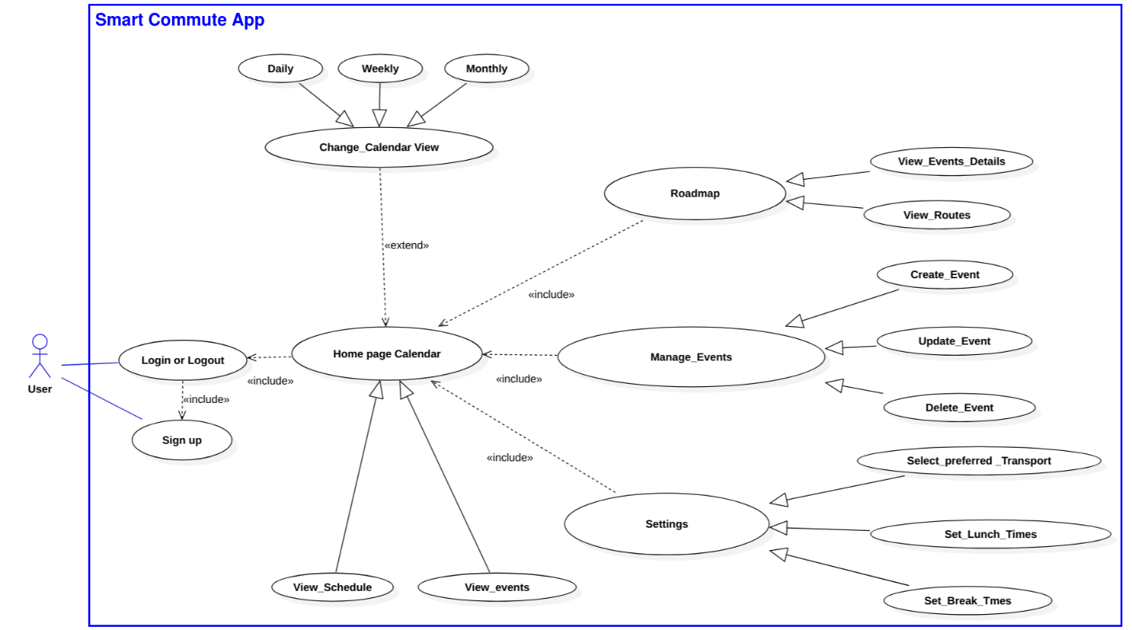
Use Case Diagram
Requirements

Slide 10
Requirements
User authentication
Calendar
Roadmap
User Setting
Smart Commute
Requirements

Slide 11
User authentication
The app will allow the user to access Smart Commute using an account
The app will permit multi-user access
The app must communicate with the database to interact with each user’s data
Requirements

Slide 12
Calendar
The app must provide a Calendar Interface that shows the user’s events and permits the user to interact with them
The calendar must provide a graphic representation of all user events
The calendar must provide a form popup to manage the events
The calendar must store and update the user’s events in the Database
Requirements

Slide 13
Roadmap
The Roadmap will have a map and a daily calendar of the current events
Requirements

Slide 14
User Settings
The app will provide a settings menu that allows the user to modify the preferences
Requirements

Slide 15
Smart Commuting
The Smart Commute must compute and validate time of the events
The Smart Commute must account for travel times for event validation
Requirements

Slide 16
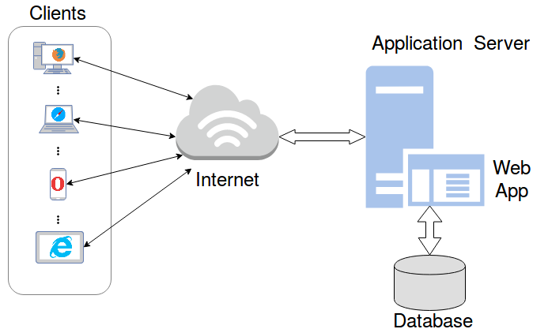
System architecture
Requirements

Slide 17
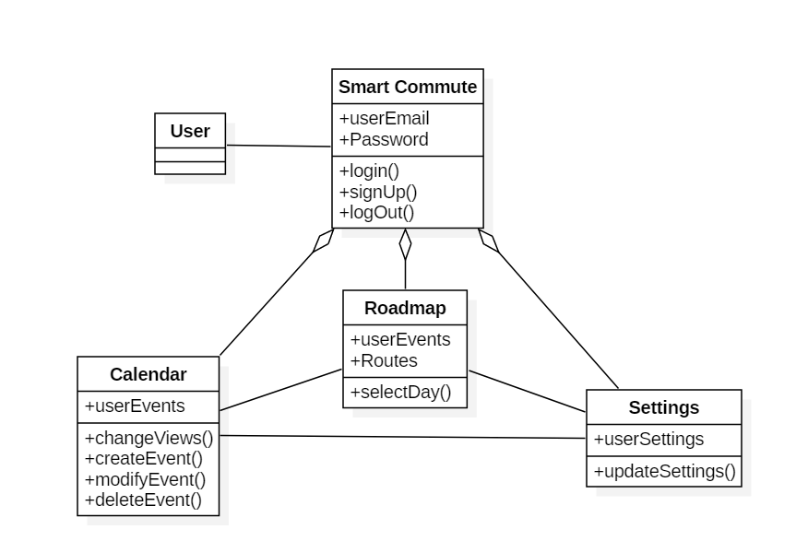
High Level Class Diagram
Design

Slide 18
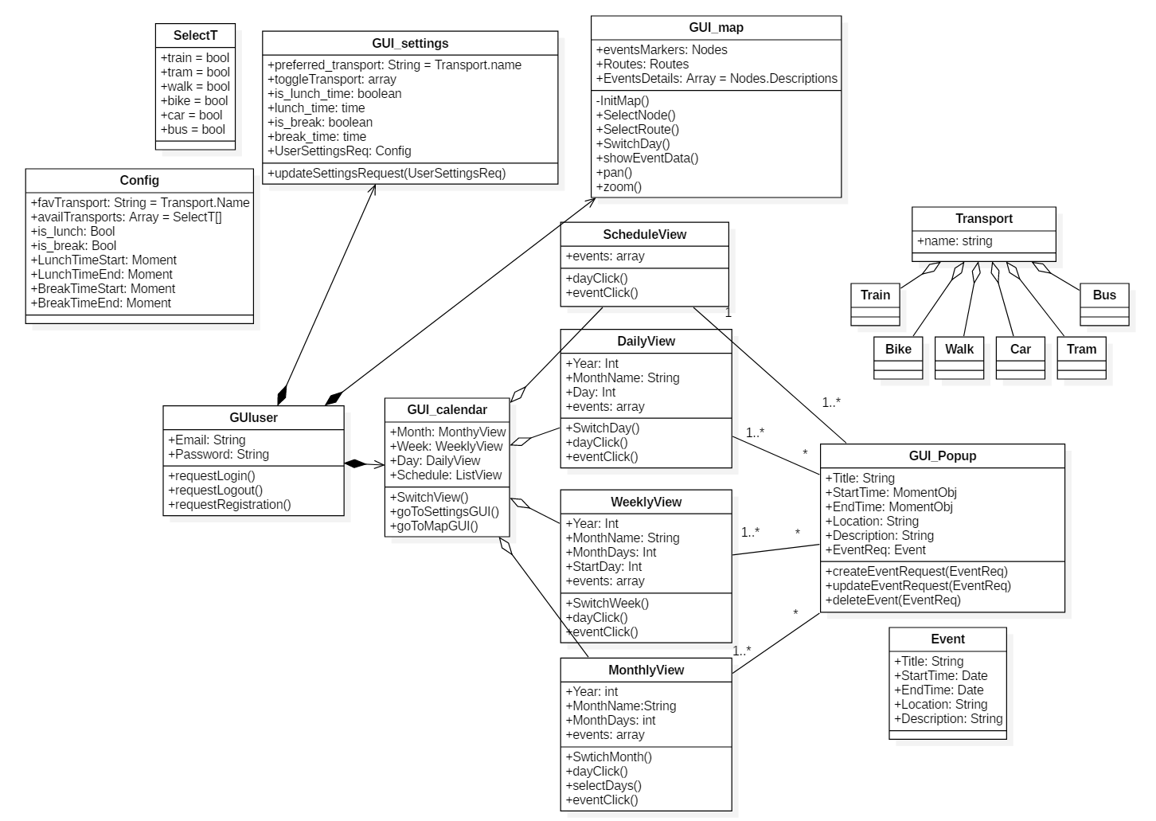
Front End Class Diagram
Design

Slide 19
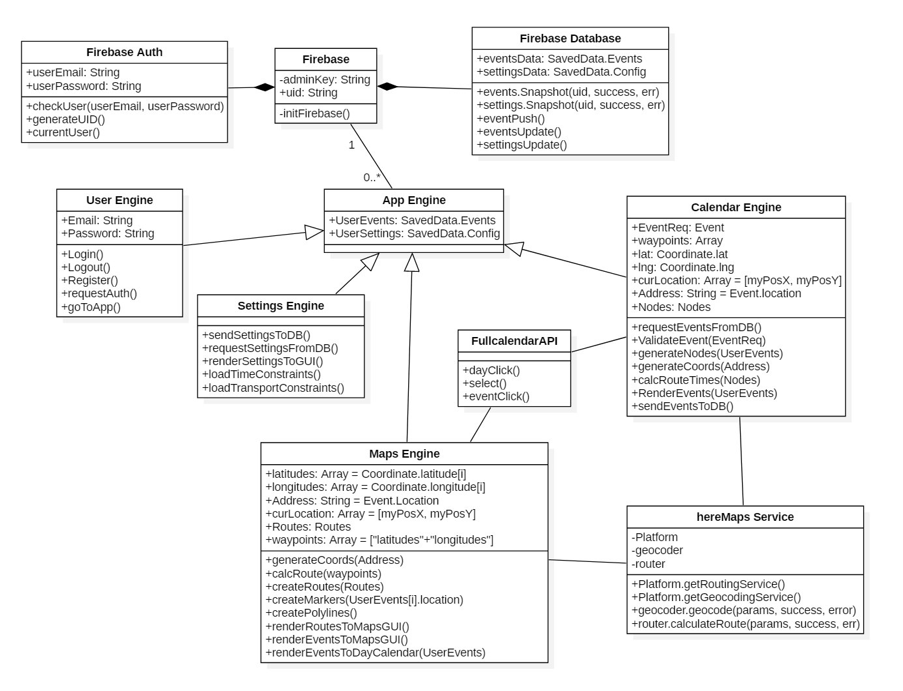
Back End Class Diagram
Design

Slide 20
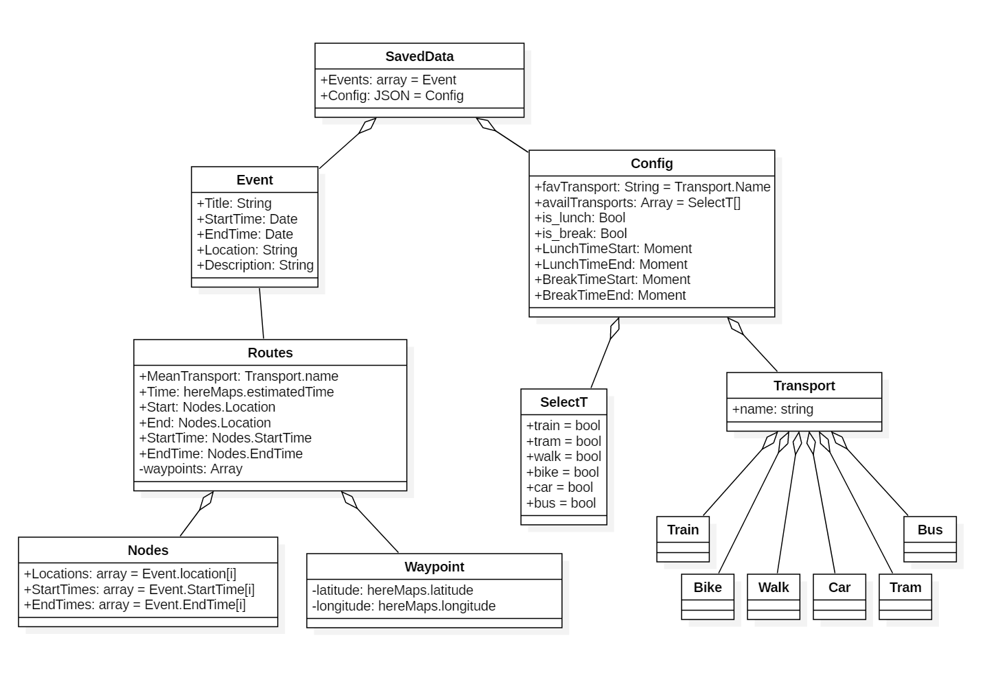
Component Class Diagram
Design

Slide 21
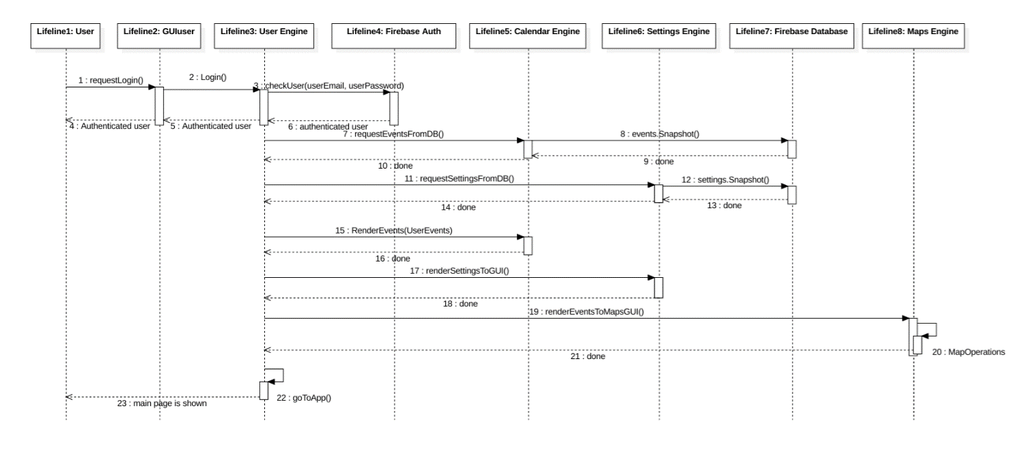
Sequence Diagram: Log in to Web App and load user data to the environment
Design

Slide 22
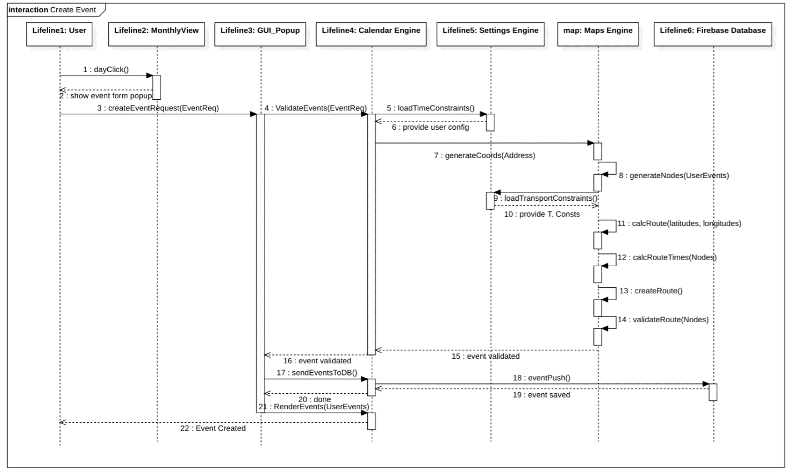
Sequence Diagram: Create an Event
Design

Slide 23
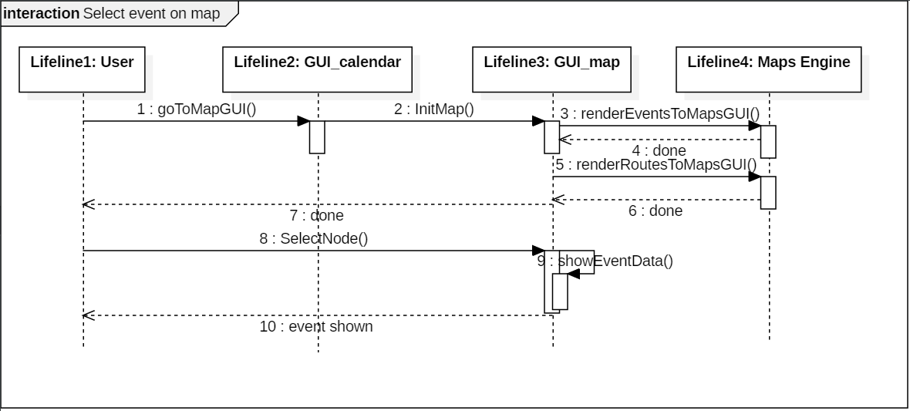
Sequence Diagram: Select an Event on Map
Design

Slide 24
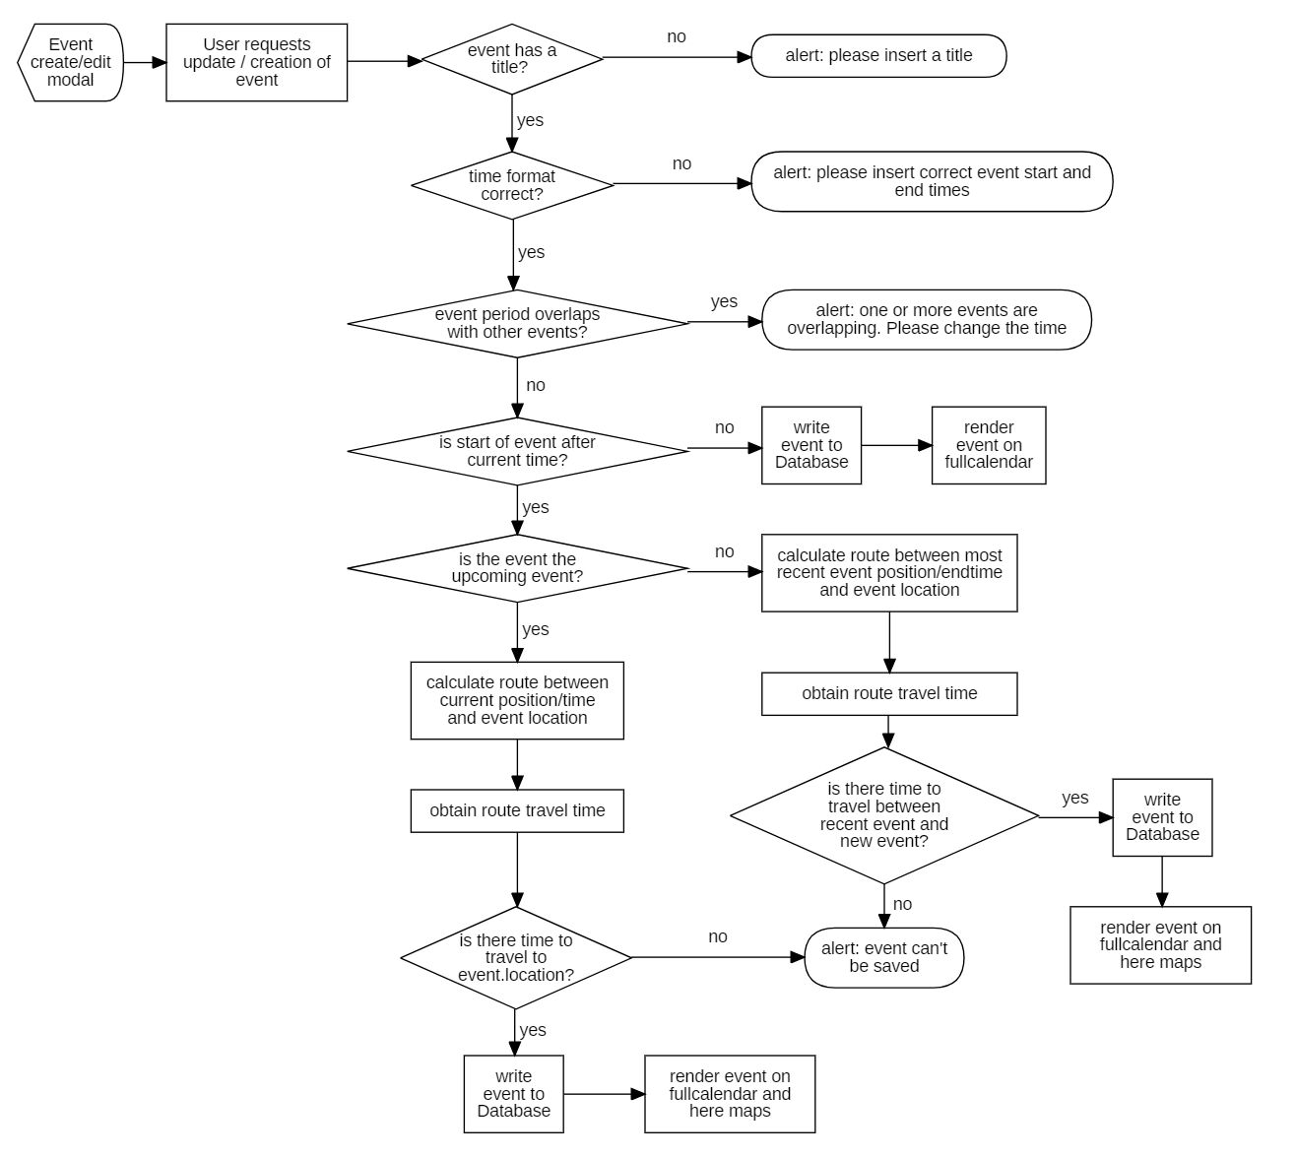
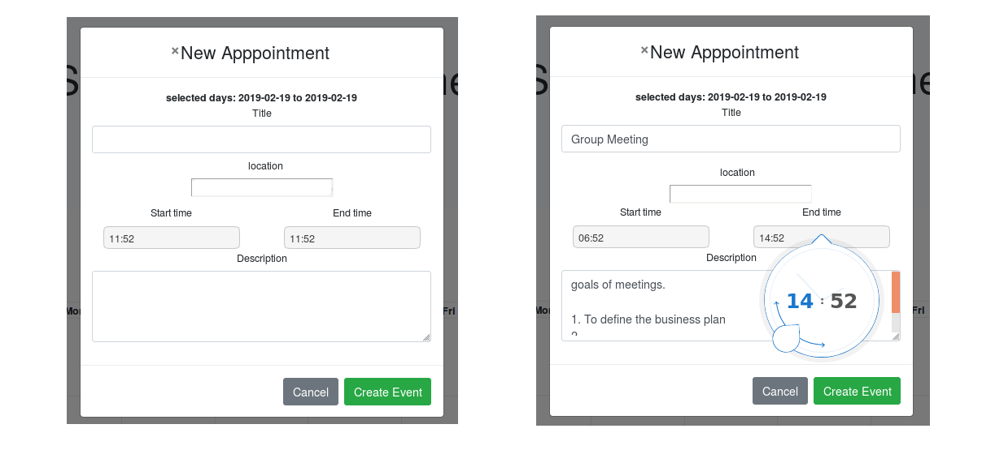
Flow Chart Diagram: Event Creation
Design

Slide 25


Flow Chart Diagram: Event Creation
Event(k+1) duration
Event(k) duration
Travel time to e(k+1)
t
Time (now)
Time gap
Event(k+1) duration
Event(k) duration
t
Time (now)
Event(k) duration
Event(k+1) duration
Travel time to e(k+1)
t
Time (now)
Time gap
Design

Slide 26
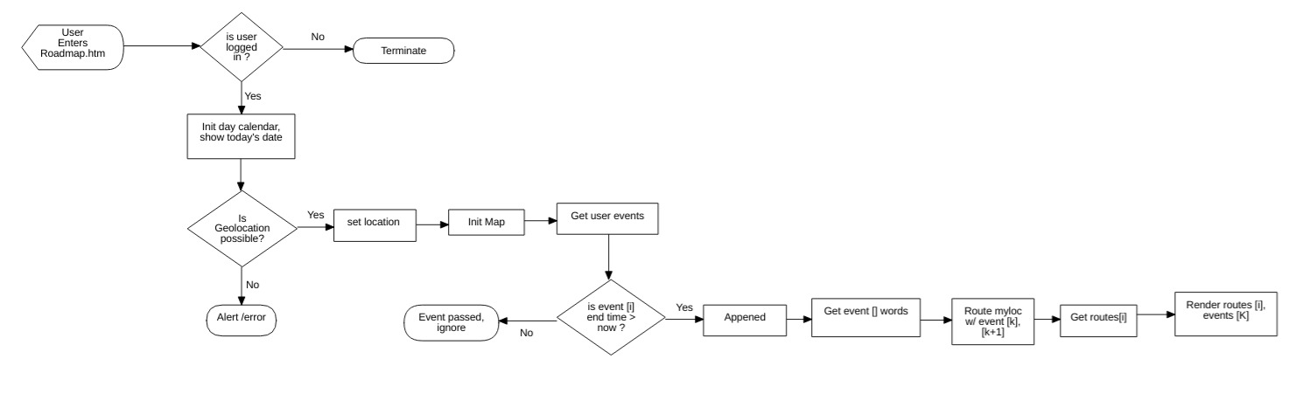
Flow Chart Diagram: Roadmap
Design

Slide 27
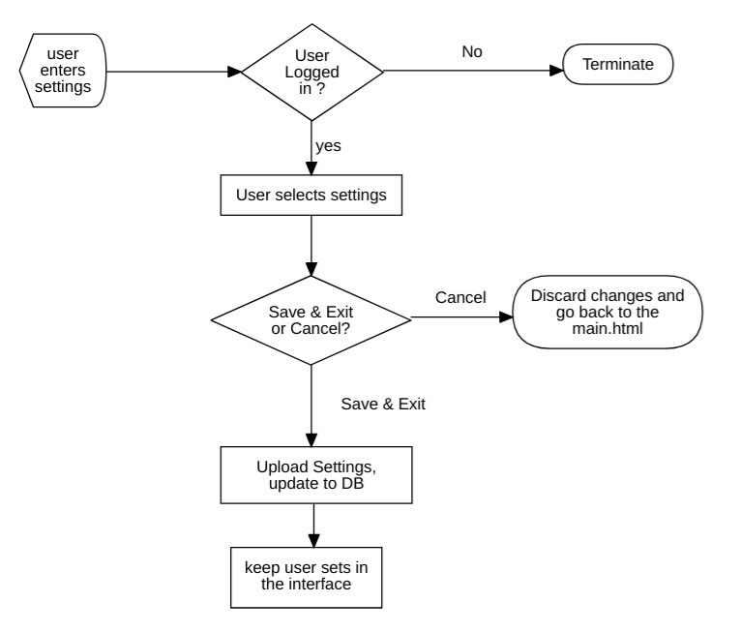
Flow Chart Diagram: Settings
Design

Slide 28
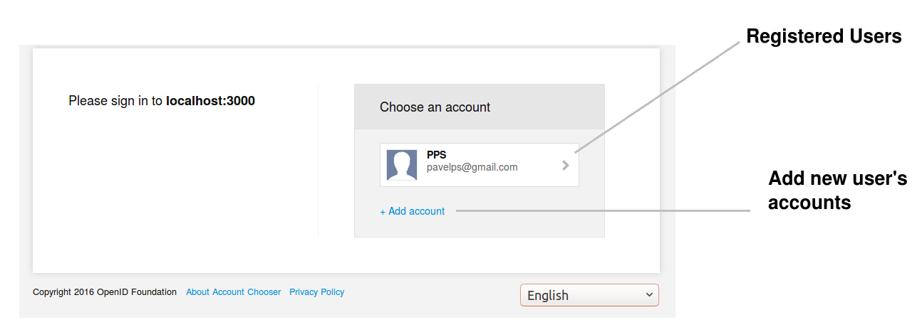
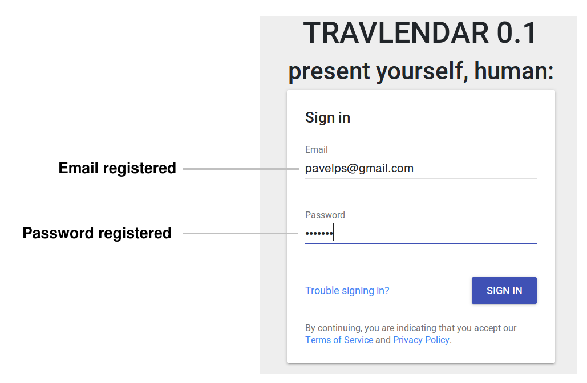
GUI User (Authentication interface)
Implementation

Slide 29
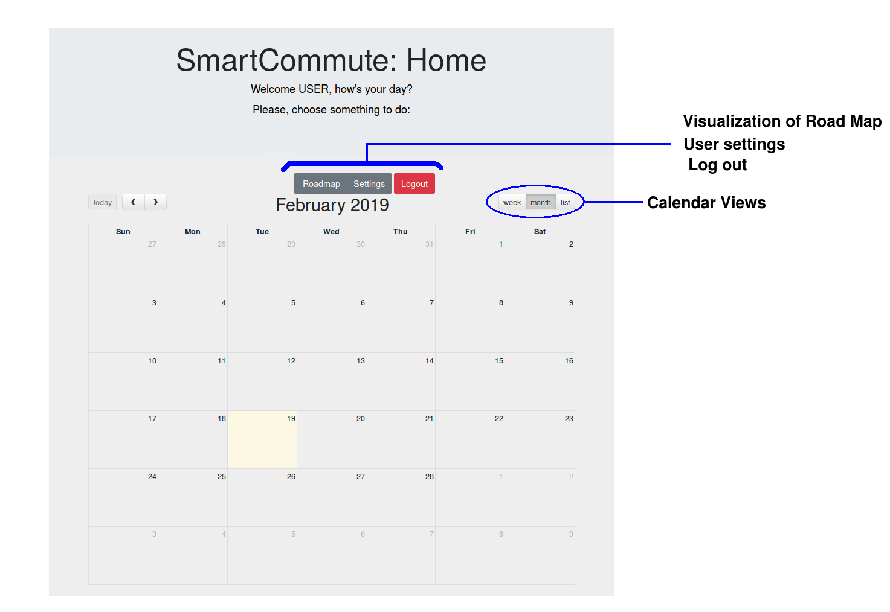
GUI Calendar (Main Page)
Implementation

Slide 30
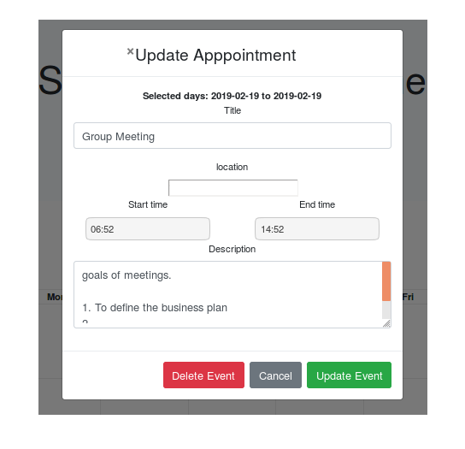
GUI Event Popup
Implementation

Slide 31
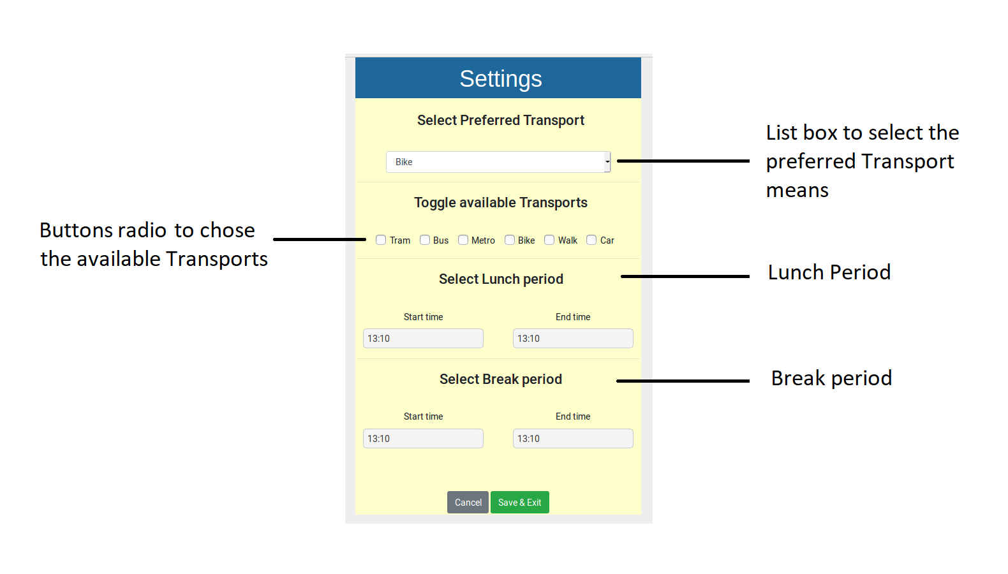
GUI Settings
Implementation

Slide 32
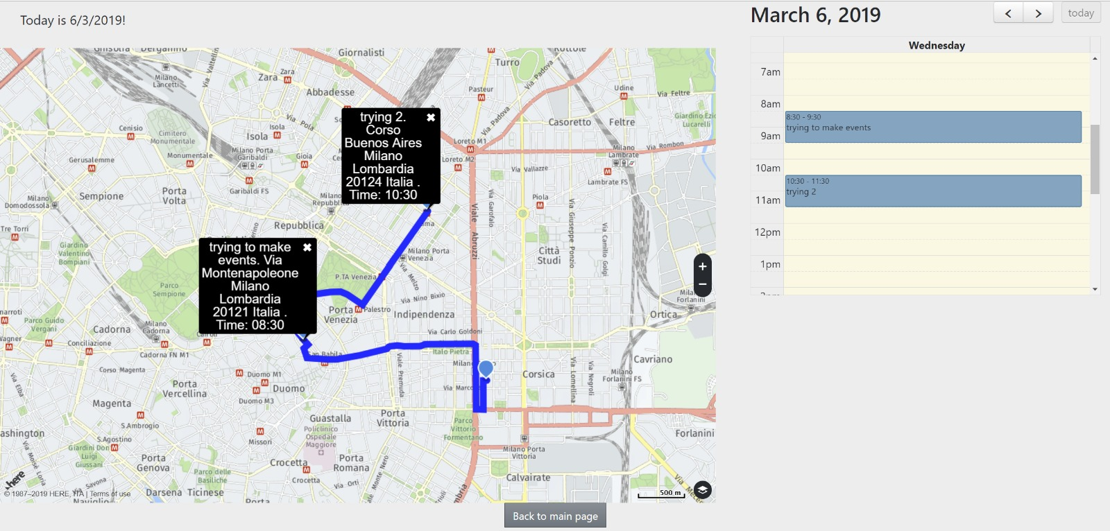
GUI Road Map
Implementation

Slide 33
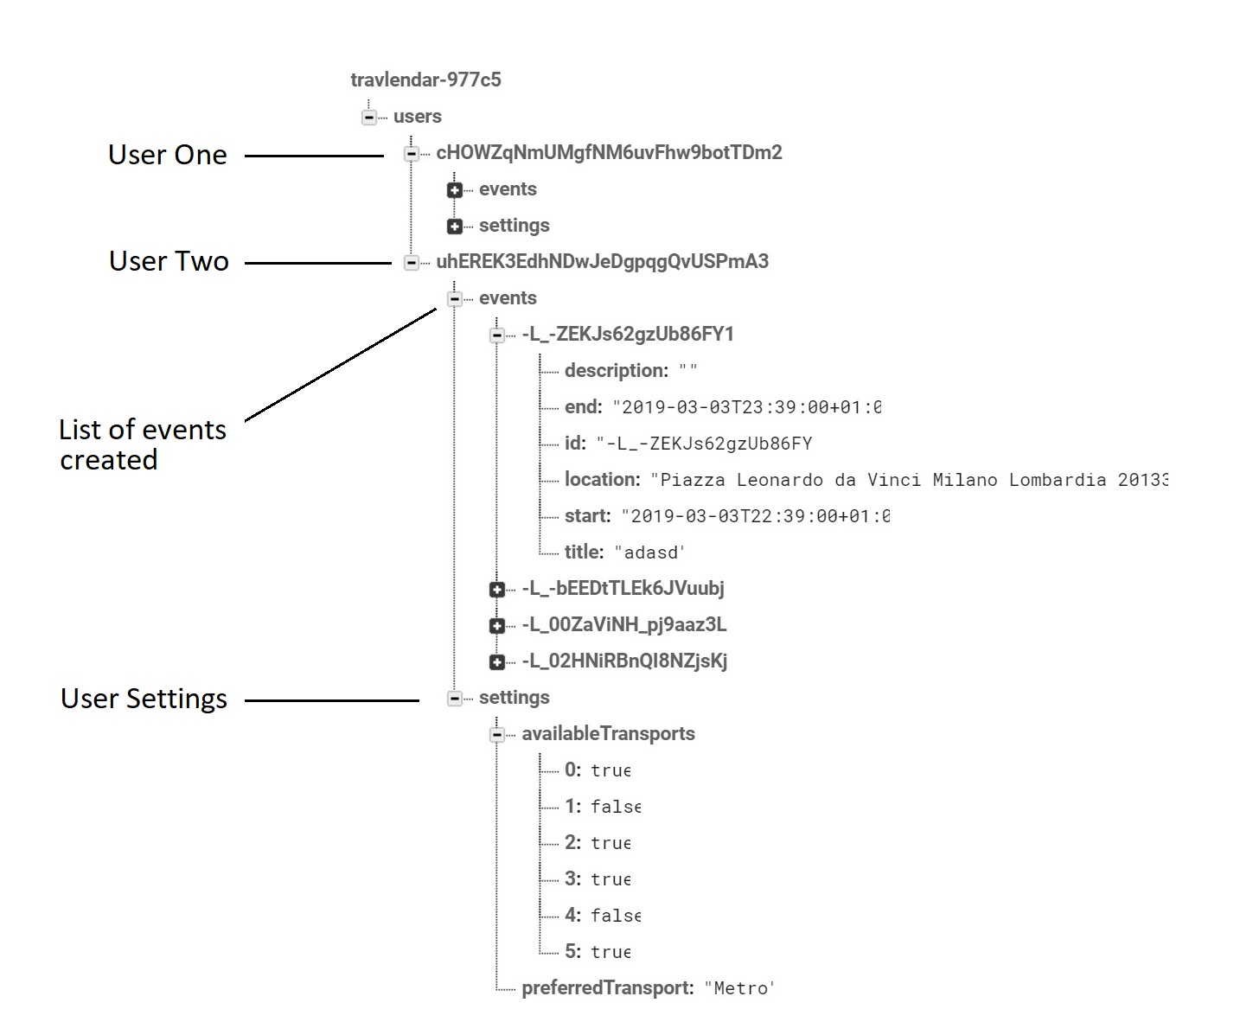
Database (Firebase)
Implementation

Slide 34
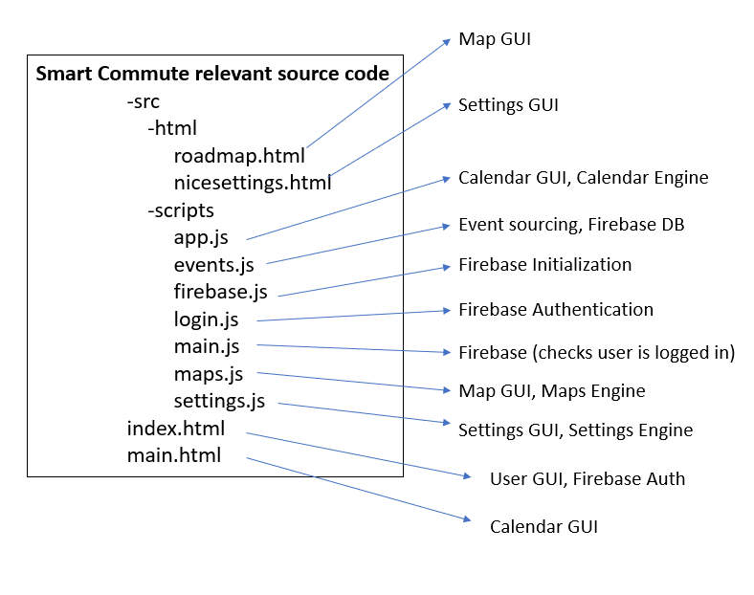
Structure of Web App code
Implementation

Slide 35
Structure of Web App code
Initializes FullCalendar ({day click, and event click functions});
If user clicks a day {
Set values ();
If user clicks submit {
Define the event data;
Check if event has title;
Validate event ();}
If user clicks an event {
Set values ();
If user clicks update {
Define event data;
Check if event has title;
Validate event ();
If user clicks delete {deletes event};
--some secondary functions--
Function: Validate event () {
If event times are correct {
Retrieve other events
Check no time overlap between any event
Generate nodes
Geocode event addresses
Calculate route times
Check there’s time to travel for previous and following event
Create / Update event};
Initializes FullCalendar ({with only day view, allow to toggle days});
Checks user authentication successful;
Gets user’s current location and define as latitude and longitude;
Initialize HERE maps platform;
Obtain user ID from firebase auth;
Retrieve all user events {
Rearrange the events, sort them from recent to old;
Filter out events that passed;
Declare waypoints variable and append current location as first waypoint;
For each event {
Get event coordinates (latitude, longitude) and append each waypoint};
For each waypoint {
Get event route from checkpoint pairs};
Initialize map UI;
For each event and route {
Generate markers;
Generate polylines;
Render event as marker, route as polyline};
Maps Engine (maps.js)
Calendar Engine (app.js)
Initializes get settings function;
Checks user authentication and retrieves id;
Retrieves from firebase database the settings data () {
Loads the data on front end;}
If user clicks save & exit button {
Listens to all user config input and sets it as variables;
Parses the input data into the Saved Data format to write to the database;
Writes the user settings onto the interface;
Overwrites the user settings in the Database with new ones;}
Settings engine (settings.js)
Implementation

Slide 36






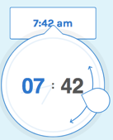

Used Tools
Front End
Back End
Implementation

Slide 37
Testing – end-to-end
User creates an event
Submit event with null title
Submit event with incorrect times
User Modifies an event
User modifies its settings
Roadmap GUI
Update event with null title
Delete any preexisting event
User Deletes an event
User Changes Settings
User enters in the roadmap
Submit event successfully
Submit a second event which overlaps with first one
Submit a second event with too large travel duration to get there
Update event with incorrect times
Update event successfully
Update second event which overlaps with first one
Update a second event with too large travel duration to get there
Testing

Slide 38
Conclusions
Solution to simplify the process of scheduling: dynamic agenda
Web-based nature: versatility + compatibility
Web-app development process was waterfall model: + organization, order in documentation, constant feedback
Implementation was limited due to complexity + time constraints
Conclusion and Future work

Slide 39
Future work
Better management on asynchronous calls: occasional errors on map rendering
Integrate user settings data as constraints in the calendar and map engines
Geolocation doesn’t have to be done twice: coordinates can be added to events directly in calendar engine
Rendering of events and routes be day exclusive
Add route duration details on popups
Conclusion and Future work

